Slide 1


Data Visualization Through Their Graph Representation
Weber, Huang
GIDS TMU

Slide 2
Summary
Due to advances in data collection, computerization of transactions, and breakthroughs in storage technology, the amount of data and information collected and retained by organizations and businesses is constantly increasing. New application areas such as biochemical pathways, web documents, etc. produce data with inherent structure that cannot be simply captured by numbers.
Visual data mining techniques have proven to be of particularly high value in exploratory data analysis, as indicated by there search in this area.
In this chapter, we focus on the visual exploration of data through their graph representations. Several examples are used to illustrate the techniques.

Slide 3
Outline
Data and Graphs
Graph Layout Techniques
Force-directed Techniques
Multi-dimensional Scaling
The Pulling Under Constraints Model
Bipartite Graphs
Discussion and Concluding Remarks

Slide 4


Graphs are useful entities since they can represent relationships between sets of objects
Data and Graphs
Graph Layout Techniques
Force-directed Techniques
Multi-dimensional Scaling
The Pulling Under Constraints Model
Bipartite Graphs
Discussion and Concluding Remarks
Object
Object
Object
Object

Slide 5
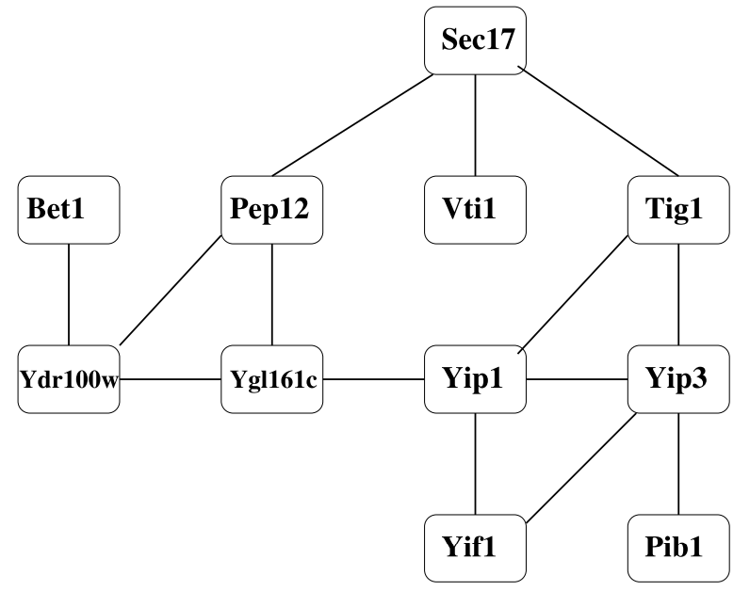
Example(1/3) Protein interaction network
Data and Graphs
Graph Layout Techniques
Force-directed Techniques
Multi-dimensional Scaling
The Pulling Under Constraints Model
Bipartite Graphs
Discussion and Concluding Remarks

Slide 6
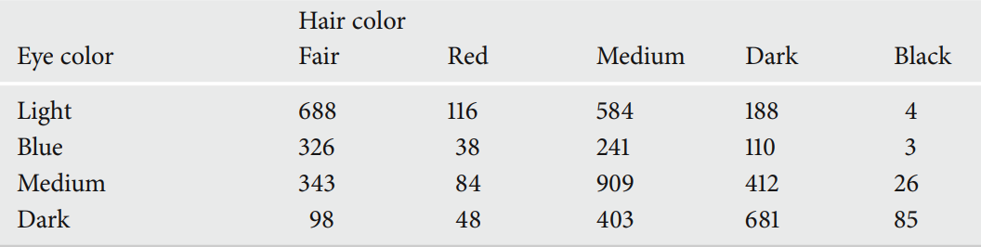
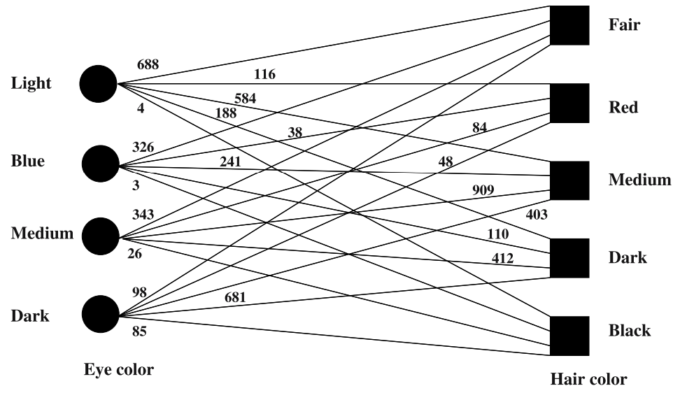
Example(2/3) Contingency table
Data and Graphs
Graph Layout Techniques
Force-directed Techniques
Multi-dimensional Scaling
The Pulling Under Constraints Model
Bipartite Graphs
Discussion and Concluding Remarks

Slide 7
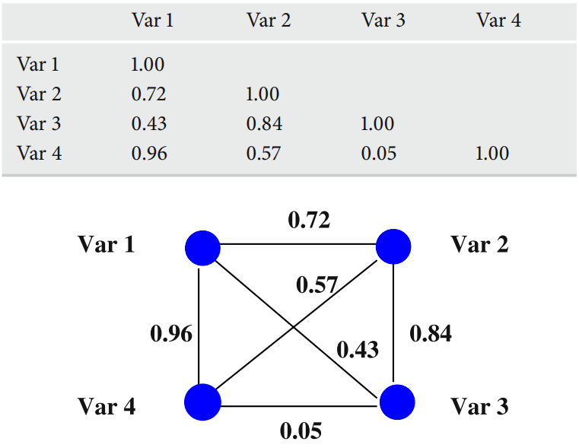
Example(3/3) Correlation matrix
Data and Graphs
Graph Layout Techniques
Force-directed Techniques
Multi-dimensional Scaling
The Pulling Under Constraints Model
Bipartite Graphs
Discussion and Concluding Remarks

Slide 8
Graph drawing/layout identification and rules (1/2)
Data and Graphs
Graph Layout Techniques
Force-directed Techniques
Multi-dimensional Scaling
The Pulling Under Constraints Model
Bipartite Graphs
Discussion and Concluding Remarks
Given a set of nodes connected by a set of edges, identify the positions of the nodes in some space and calculate the curves that connect them.
Many layout algorithms are based on a set of aesthetic rules that the drawing needs to adhere to :
Nodes and edges must be evenly distributed
Edges should have similar lengths
Edge crossings must be kept to a minimum

Slide 9
Graph drawing/layout identification and rules (2/2)
Data and Graphs
Graph Layout Techniques
Force-directed Techniques
Multi-dimensional Scaling
The Pulling Under Constraints Model
Bipartite Graphs
Discussion and Concluding Remarks
A basic layout is obtained by a computationally fast algorithm, and the resulting drawing is post processed to adhere to such aesthetic rules.

Slide 10
Data and Graphs
Graph Layout Techniques
Force-directed Techniques
Multi-dimensional Scaling
The Pulling Under Constraints Model
Bipartite Graphs
Discussion and Concluding Remarks
The purpose is to position the nodes of a graph in two-dimensional or three-dimensional space so that all the edges are of more or less equal length and there are as few crossing edges as possible, by assigning forces among the set of edges and the set of nodes, based on their relative positions, and then using these forces either to simulate the motion of the edges and nodes or to minimize their energy.

Slide 11
Data and Graphs
Graph Layout Techniques
Force-directed Techniques
Multi-dimensional Scaling
The Pulling Under Constraints Model
Bipartite Graphs
Discussion and Concluding Remarks
Multidimensional scaling (MDS) is a means of visualizing the level of similarity of individual cases of a dataset. MDS is used to translate "information about the pairwise 'distances' among a set of n objects or individuals" into a configuration of n points mapped into an abstract Cartesian space.

Slide 12
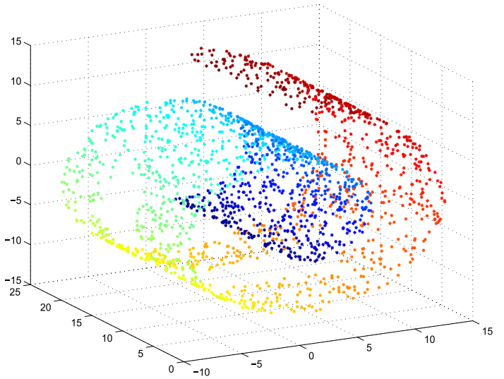
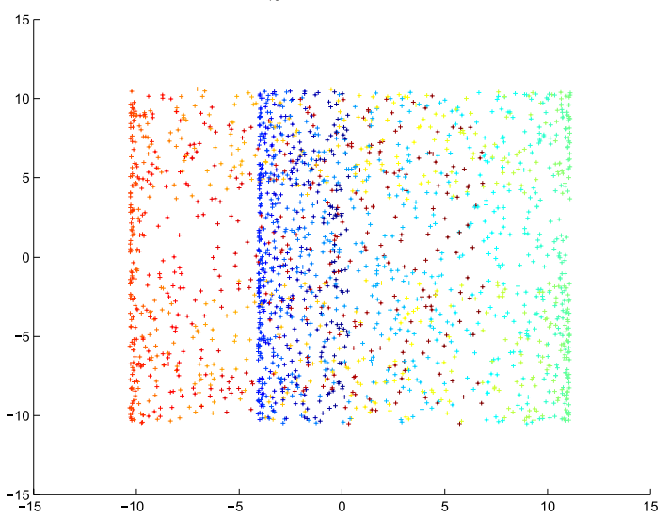
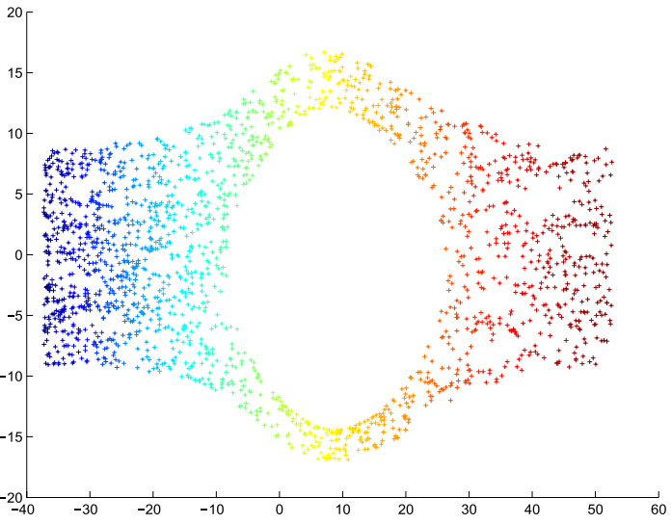
Example
Data and Graphs
Graph Layout Techniques
Force-directed Techniques
Multi-dimensional Scaling
The Pulling Under Constraints Model
Bipartite Graphs
Discussion and Concluding Remarks

Slide 13
Data and Graphs
Graph Layout Techniques
Force-directed Techniques
Multi-dimensional Scaling
The Pulling Under Constraints Model
Bipartite Graphs
Discussion and Concluding Remarks

Slide 14
Data and Graphs
Graph Layout Techniques
Force-directed Techniques
Multi-dimensional Scaling
The Pulling Under Constraints Model
Bipartite Graphs
Discussion and Concluding Remarks

Slide 15
Data and Graphs
Graph Layout Techniques
Force-directed Techniques
Multi-dimensional Scaling
The Pulling Under Constraints Model
Bipartite Graphs
Discussion and Concluding Remarks

Slide 16
Data and Graphs
Graph Layout Techniques
Force-directed Techniques
Multi-dimensional Scaling
The Pulling Under Constraints Model
Bipartite Graphs
Discussion and Concluding Remarks

Slide 17
Data and Graphs
Graph Layout Techniques
Force-directed Techniques
Multi-dimensional Scaling
The Pulling Under Constraints Model
Bipartite Graphs
Discussion and Concluding Remarks

